Slide 1
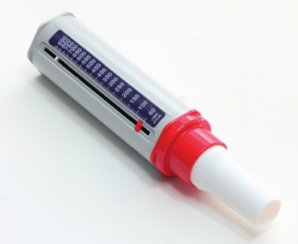
* Learning Objective: p 166
Peak flow
Success Criteria:
What is it ?
Why is it important?
How do you measure it ?
Why am I doing this ?
How healthy are your lungs ?

Slide 2
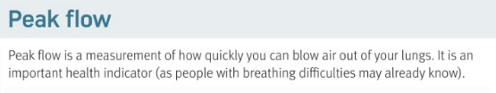
https://www.youtube.com/watch?v=jdA8KU_D9JU
In your books – what is peak flow ?

Slide 3
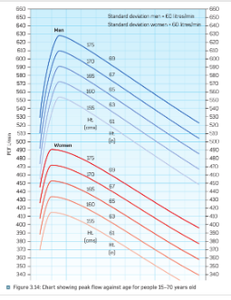

Slide 4
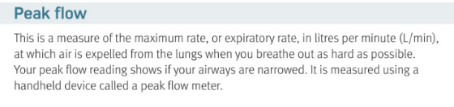
In your books – what is peak flow measure in ?
How is it measured?

Slide 5
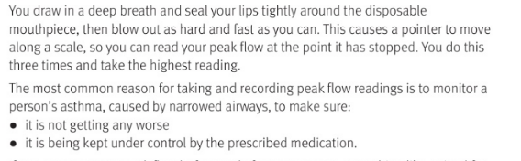

Slide 6
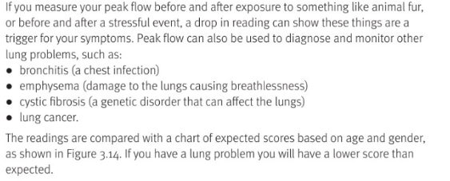
In your books – what
diseases can it measure?

Slide 7
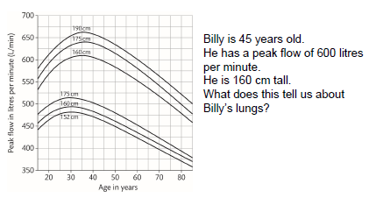

Slide 8
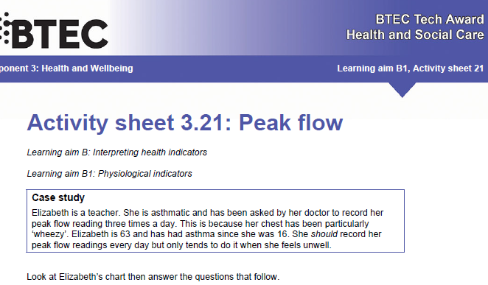

Slide 9
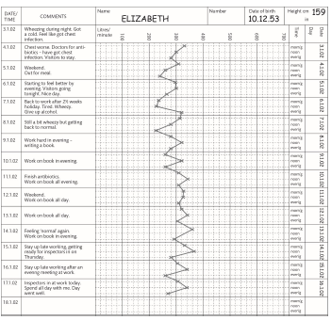

Slide 10
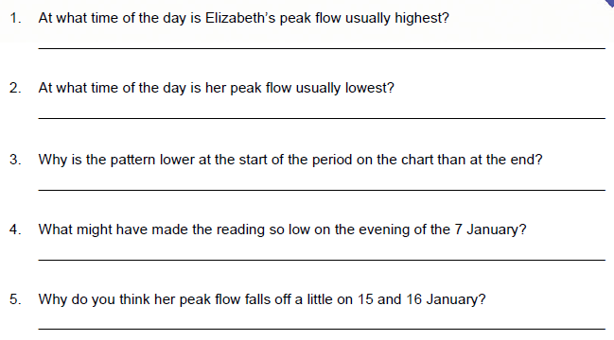
Noon / midday
Evening
She is improving
stress
Stayed up late

Slide 11
H&SC c3 lab peak flow
Smhw test
https://www.youtube.com/watch?v=PzfLDi-sL3w

Slide 12
* Learning Objective: p 166
Peak flow
Success Criteria:
What is it ?
Why is it important?
How do you measure it ?
Why am I doing this ?
How healthy are your lungs ?

