Slide 1

* Learning Objective: P 192
OBSTACLES
Success Criteria
OBSTACLES
KISS
Why am I doing this ?
Things WILL get in the way – are you going to give up ?

Slide 2


Slide 3
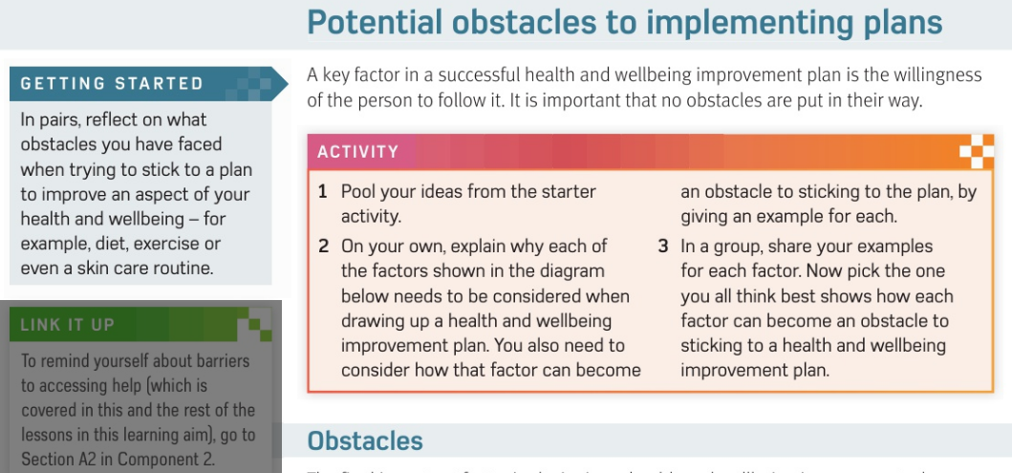

Slide 4
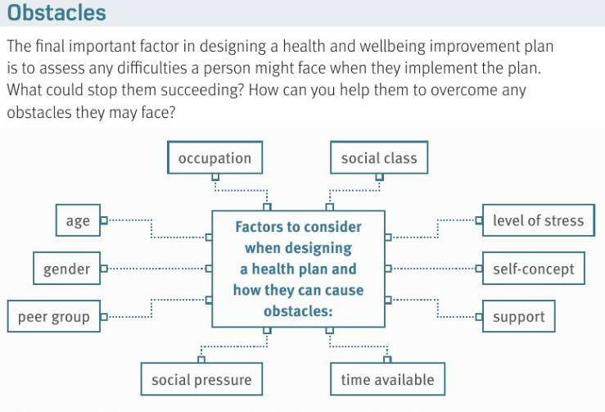

Slide 5
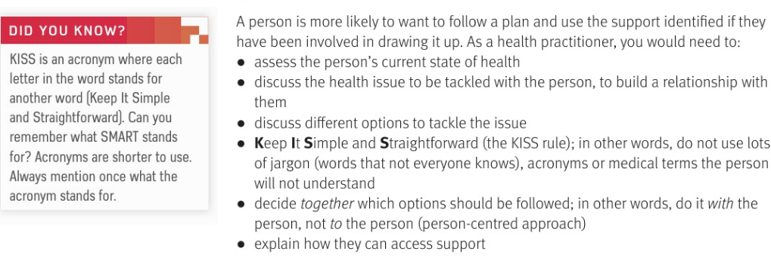


Slide 6
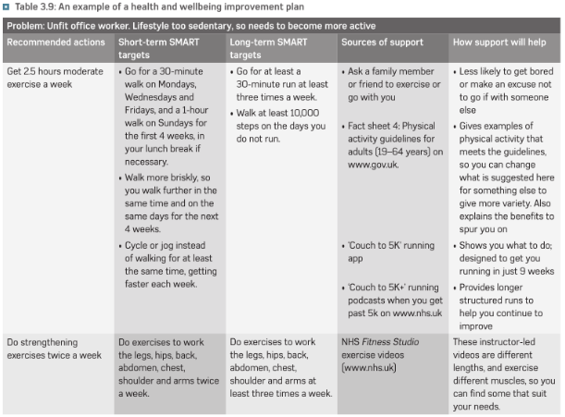

Slide 7
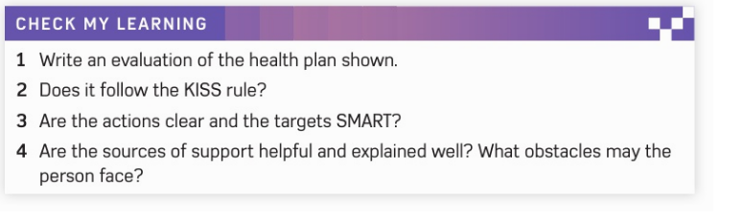

Slide 8
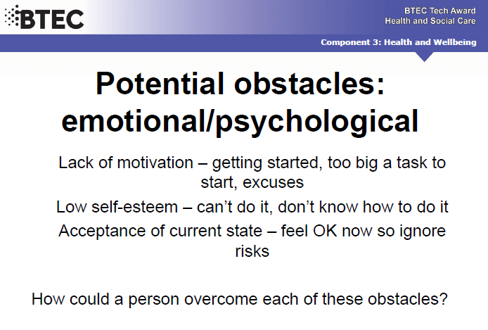

Slide 9
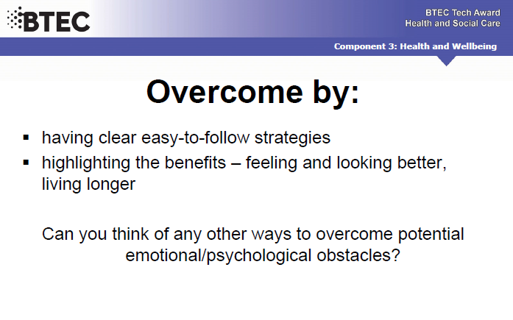

Slide 10
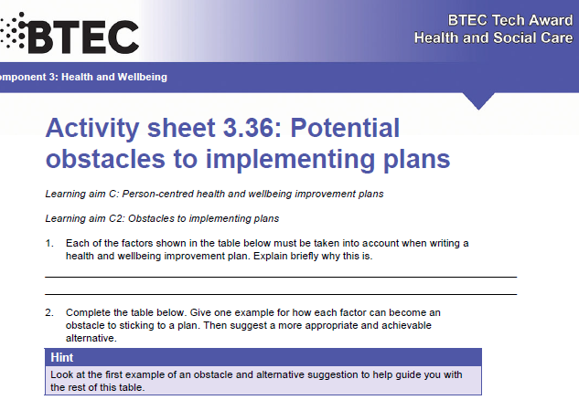

Slide 11
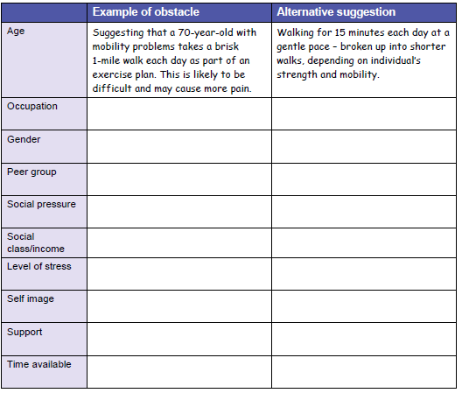

Slide 12
SMHW
No quiz this time- Obstacles 2 next
Video
https://www.youtube.com/watch?v=F2-H7botZBg
Ex - https://www.youtube.com/watch?v=z7iWZ24NXQQ

Slide 13
* Learning Objective: P 192
OBSTACLES
Success Criteria
OBSTACLES
KISS
Why am I doing this ?
Things WILL get in the way – are you going to give up ?

