Slide 1

* Learning Objective: p 154
Impact of Life events relating to relationship changes
Success Criteria:
Impacts on health & wellbeing
Entering into a relationship
Marriage / Partnership
Parenthood
Divorce
Bereavement
Why am I doing this ?
These things will happen to all of us

Slide 2
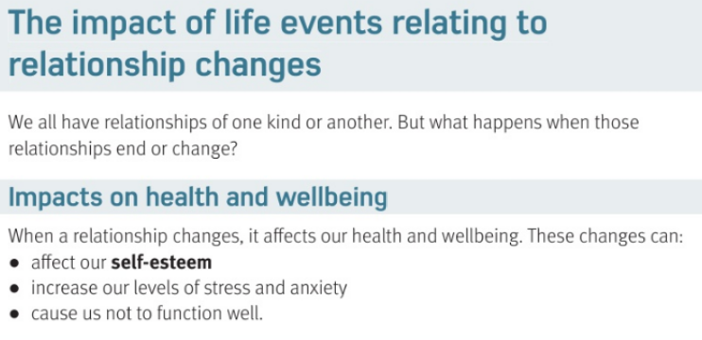

Slide 3
Impact of relationship Changes
When a relationship changes it affects our: | 1 Self…
 | 2. Levels of..
 | 3.Cause us not to..
ESTEEM
STRESS
FUNCTION

Slide 4
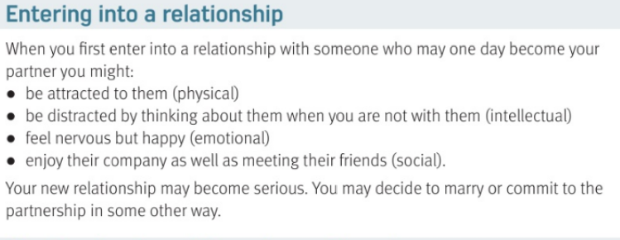

Slide 5
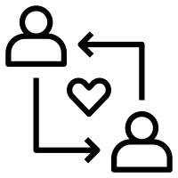
Effects of Starting a relationship: | P
 | I
 | E
 | S
PHYSICAL ATTRACTION
LEARN NEW THINGS
FEEL HAPPY
MEET NEW FRIENDS

Slide 6
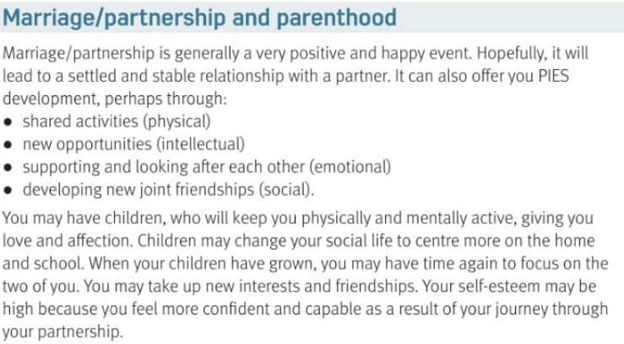

Slide 7

EFFECTS OF MARRIAGE | P
 | I
 | E
 | S
EXERCISE TOGETHER
LEARN NEW THINGS TOGETHER
SUPPORT EACH OTHER
HANG OUT WITH EACH OTHERS FRIENDS

Slide 8
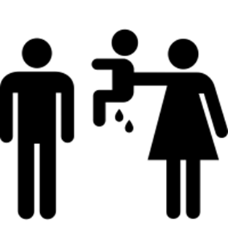
EFFECTS OF HAVING CHILDREN | P
 | I
 | E
 | S
TIRED
CANT CONCENTRATE
FEEL LOVE
LESS FRIENDS / MORE HOME

Slide 9
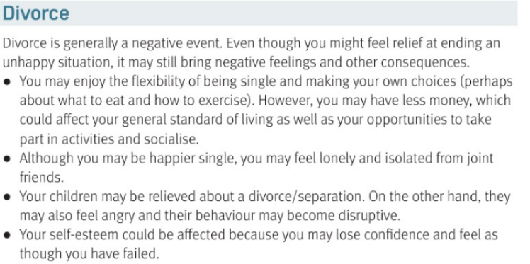

Slide 10
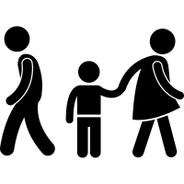
Effects OF DIVORCE | P
 | I
 | E
 | S
LESS MONEY ; LESS FOOD
CANT CONCENTRATE
FEEL DEPRESSED
LOSE FRIENDS

Slide 11
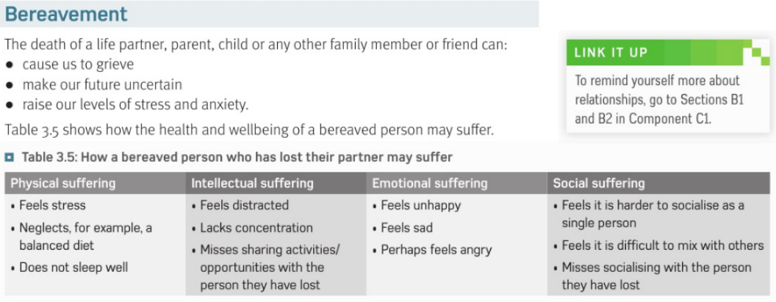

Slide 12

EFFECTS OF BEREAVEMENT | P
 | I
 | E
 | S
HEART STRAIN
LOSE INTEREST IN THINGS
GRIEVE
LOSE FRIENDS

Slide 13
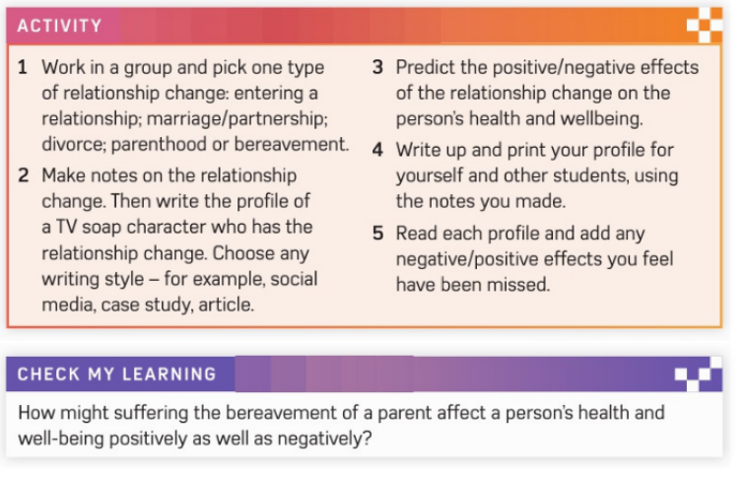

Slide 14
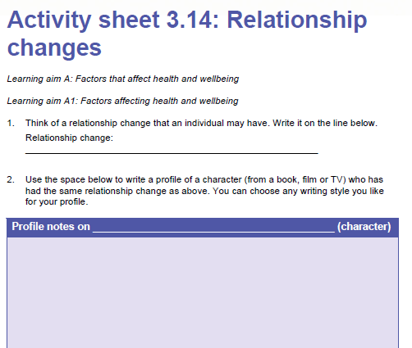

Slide 15
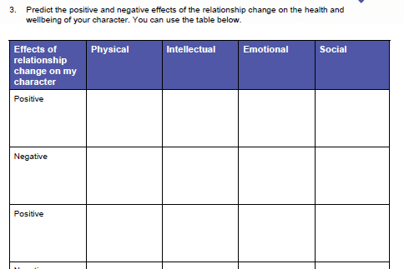

Slide 16
Smhw JUST TRY LAST LESSONS
c3 laa definitions & GENETICS & housing
Video
https://www.youtube.com/watch?v=1Fsb7F-H_E8

Slide 17
* Learning Objective: p 154
Impact of Life events relating to relationship changes
Success Criteria:
Impacts on health & wellbeing
Entering into a relationship
Marriage / Partnership
Parenthood
Divorce
Bereavement
Why am I doing this ?
These things will happen to all of us

