Slide 1
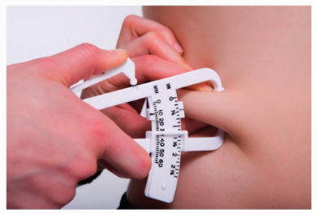
* Learning Objective: p 170
Using Published Guidelines
Success Criteria:
Published guidelines
Baseline assessments
Limitations
Presenting assessments
Reasoned judgements
Why am I doing this ?
They help us know if things are Healthy or Not

Slide 2
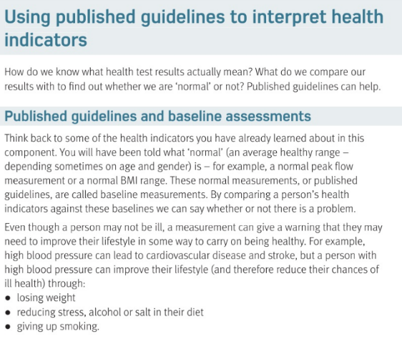

Slide 3
Using Published Guidelines
Using published guidelines help us see if our test results are ..
Normal is not a single number but …
Its different depending on
Even though a person may not be ill a measurement can give a That allows you to .
Normal
A healthy range
Age & gender
warning
Take action

Slide 4
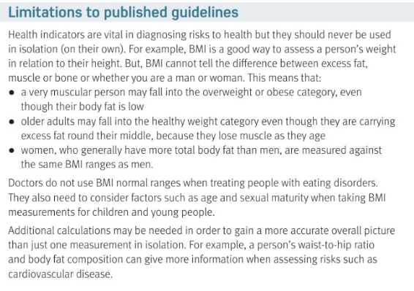

Slide 5
Guidelines are good but should never be used on their..
For Example BMI cant tell the difference between fat and..
Also for example, women naturally have more __________ than men
own
muscle
Body fat

Slide 6
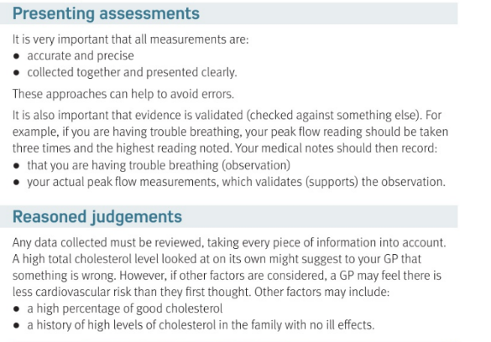

Slide 7
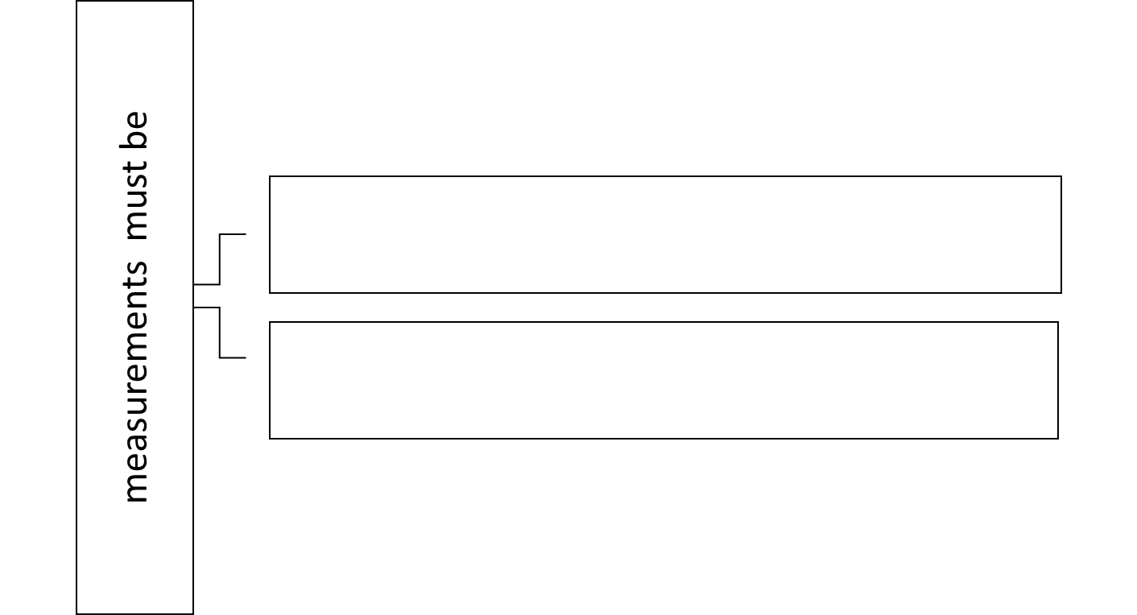
Accurate & precise
Collected and clear
Evidence must be validated which means
A reasoned judgement doesn’t only look at ..
checked
One thing

Slide 8
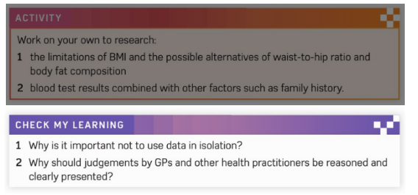

Slide 9
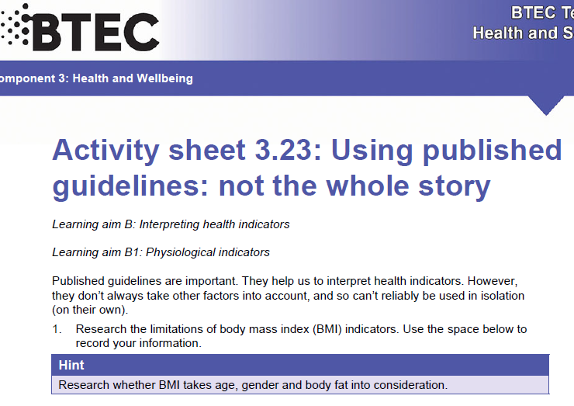

Slide 10
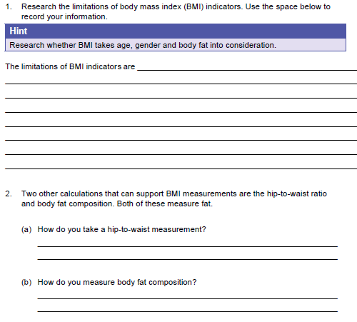
Cant tell between fat & muscle, man & woman
https://www.youtube.com/watch?v=e4cUSNq_OY8
https://www.youtube.com/watch?v=hvC2TDs95xY

Slide 11
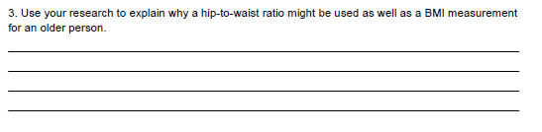
Because older people LOSE Muscle which leads to a poor bmi

Slide 12

Smhw
Guidelines
H&SC c3 lab guidelines

Slide 13
* Learning Objective: p 170
Using Published Guidelines
Success Criteria:
Published guidelines
Baseline assessments
Limitations
Presenting assessments
Reasoned judgements
Why am I doing this ?
They help us know if things are Healthy or Not

