Slide 1
Eduqas GCSE English Language
Writing Tasks
Talk/Speech

Slide 2
Aims of this presentation
introduce talk/speech writing
discuss features of talk/speech writing
focus on specific talk/speech writing tasks
share tips and look at how to write a successful talk/speech
consider sample plans and extracts
provide full marked examples
link to a revision sheet on talk/speech writing

Slide 3
Writing a talk/speech: key information
What do you need to know?
Audience
Who are you writing your talk/speech for? Is there anything you need to consider when writing to this particular audience?
Knowing who your audience is may influence the tone of your work – pay careful attention to this.
Purpose
What is your talk/speech trying to achieve? For example, you may need to do at least one of the following:
give information or advice
persuade your audience
give your views

Slide 4
Writing a talk/speech: key information
Content
What are the main points you want to make?
Think about whether these points are clearly focused on the task that has been set.
Think about whether your points are consistent and the most logical way of presenting them.
Register
What is the appropriate tone for your writing?
A talk/speech can be less formal than other forms of writing – you should be guided by who the audience is. The tone should be respectful but it may be possible to use humour and more light-hearted language – particularly if you are writing for an audience that you know (such as your class).
Format
What do you need to know about layout?
There are no special instructions for this kind of writing. A talk should be written exactly as you would say it. You must set it out as a piece of accurate writing and carefully organise your writing into paragraphs. You should not use speech marks. Do not set this work out as part of a script with stage directions.

Slide 5
Features: layout
Think carefully about the structure of your talk. The following features may help you to organise your writing:
Introduction | In this section you may wish to introduce yourself and you will certainly need to introduce your talk/speech. Give your audience a sense of what you will be talking about. It may be useful to try to grab the audience’s attention at this point – think about whether you can use a persuasive device effectively to do that.
Paragraphs | Plan your content carefully into separate paragraphs. Think about ways you can link your paragraphs together so that your talk/speech seems cohesive and fluent.
Conclusion | Make sure you include a concluding paragraph that recaps (briefly) on what you have said and is focused on the task. You may wish to leave the audience with a clear reminder of your most important point or with a final thought-provoking message.

Slide 6
Features: layout
Opening:
Make sure you begin your talk/speech clearly and with purpose:
E.g.
Some newspapers present a pretty awful picture of the behaviour of celebrities but does this mean that we should not have celebrity role models? I don’t think so. Let’s think about some of the celebrities that make a positive difference to society every day…
Good afternoon. To open this talk today, let me pose a question. How often do you go out of your way to help other people?
I am here today to represent Y11 and our views about the proposed changes to the school day. We have discussed this in form groups and as part of the school council, and I am certain that I speak for the vast majority of Year 11 when I say that we are fully opposed to the current proposals …

Slide 7
Features: layout
Concluding statement:
Make sure you end clearly and sum up your arguments in a convincing way. You should use your conclusion to revisit the task and make possible suggestions for the future:
E.g.
So while it is clear that some celebrities certainly abuse their positions there are many that do not. At the end of the day, celebrities are only a microcosm of humanity – good and bad! It is up to us to choose carefully which, if any, celebrities we allow to have influence over us.
In conclusion, there are many ways to offer something to our charity. You all possess many valuable qualities and experiences that we would love to see shared within this community.
I hope that I have clearly represented the views of Year 11. Whilst we are not opposed to changes in the school day, there are many reasons why the current proposals would not work for us or for future Year 11 groups. A few modifications to the proposals, particularly in relation to the lunch break being long enough for revision sessions, may make all the difference.

Slide 8
Writing a talk/speech: tasks
Examples of tasks:
You have been asked to give a talk to your class with the title: The person I’d most like to spend a day with. Your talk could be about a person who is famous such as a sportsperson, musician, inventor or national figure, someone from the past or someone who is not necessarily well known but who you admire. Write what you would say in your talk. [20] | Many older people do not use modern technology because they do not understand it and are perhaps afraid of it. You have been asked to give a talk to older people encouraging them to make use of modern technology. Your talk should include one or more of the following: the internet social media such as Facebook and Twitter smart phones/smart watches Tablets Write what you would say. [20]
You are asked to give a talk to people in your class about your ambitions and what you hope to achieve in the next 10 years. Write what you would say in your talk. [20] | Students often complain about being bored and having nothing to do through the long school summer holidays. You have been asked to give a talk to your class giving your views, with suggestions and recommendations for making the most of school holidays. Write what you would say. [20]

Slide 9
Getting to grips with writing a talk/speech
Many older people do not use modern technology because they do not understand it and are perhaps afraid of it.
You have been asked to give a talk to older people encouraging them to make use of modern technology.
Your talk should include one or more of the following:
the internet
social media such as Facebook and Twitter
smart phones/smart watches
Tablets
Write what you would say. [20]
To help you plan a response to this question, can you answer the following questions?
Question
Who is the audience for your talk?
What tone will you use?
Which aspect of technology will you write about? You can choose more than one.
Make a list of points that you think will be useful for each bullet point you intend to address.

Slide 10
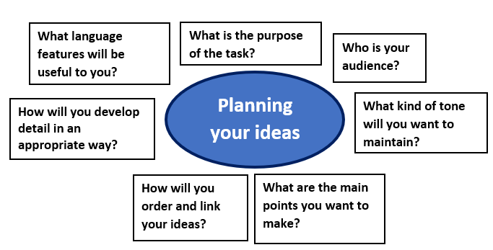
Getting to grips with writing a talk
Many older people do not use modern technology because they do not understand it and are perhaps afraid of it.
You have been asked to give a talk to older people encouraging them to make use of modern technology.
Your talk should include one or more of the following:
the internet
social media such as Facebook and Twitter
smart phones/smart watches
Tablets
Write what you would say. [20]
The questions that you answered for the previous slide will help you to create a plan for this task.
You can use this template to help.
A sample plan can be seen on the next slide.

Slide 11
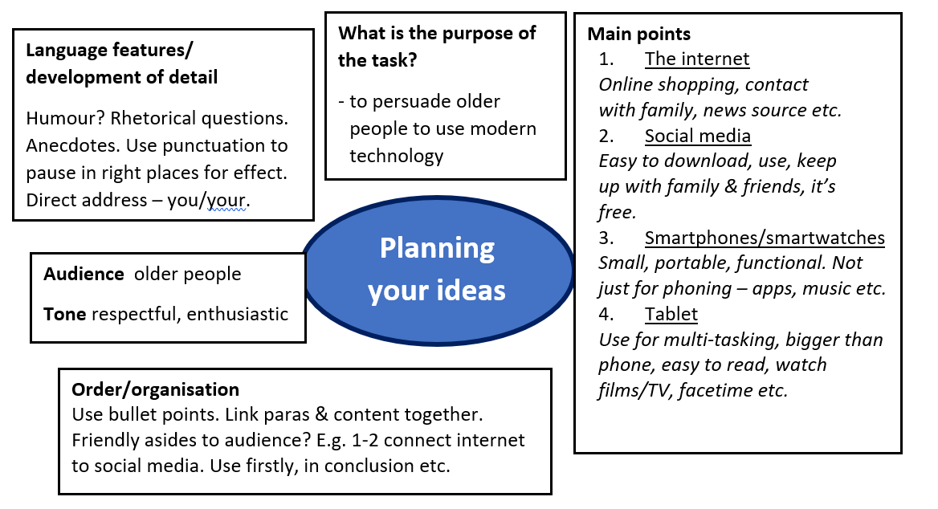
Writing a talk/speech – sample plan
Many older people do not use modern technology because they do not understand it and are perhaps afraid of it.
You have been asked to give a talk to older people encouraging them to make use of modern technology.
Your talk should include one or more of the following:
the internet
social media such as Facebook and Twitter
smart phones/smart watches
Tablets
Write what you would say. [20]

Slide 12
Writing a talk/speech – sample extract
Many older people do not use modern technology because they do not understand it and are perhaps afraid of it.
You have been asked to give a talk to older people encouraging them to make use of modern technology.
Your talk should include one or more of the following:
the internet
social media such as Facebook and Twitter
smart phones/smart watches
Tablets
Write what you would say. [20]
Look at the opening to this answer then look back at the plan on the previous page. Can you see how the plan has helped the student to write this answer?
Technology! The despair or pinnacle of our social experience? Let me tell you now that you are completely missing out if you aren’t up to date.
Firstly, there’s the internet. This network allows you to do whatever you like! You can shop online, text your grandson (just don’t tell him how much he’s grown!) and see the news. What’s not to love about a device which contains so many purposes? Nothing. Exactly.

Slide 13
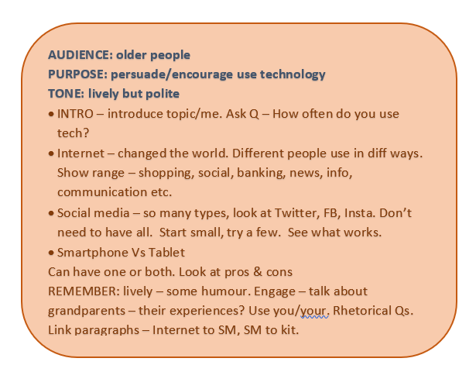
Writing a talk/speech – sample plan
Many older people do not use modern technology because they do not understand it and are perhaps afraid of it.
You have been asked to give a talk to older people encouraging them to make use of modern technology.
Your talk should include one or more of the following:
the internet
social media such as Facebook and Twitter
smart phones/smart watches
Tablets
Write what you would say. [20]

Slide 14
Writing a talk – sample extract
Many older people do not use modern technology because they do not understand it and are perhaps afraid of it.
You have been asked to give a talk to older people encouraging them to make use of modern technology.
Your talk should include one or more of the following:
the internet
social media such as Facebook and Twitter
smart phones/smart watches
Tablets
Write what you would say. [20]
Look at a middle section to this answer. Can you see how the student has worked hard to link the paragraphs together?
Social media apps can be found on the internet. All you need to do is download, sign up and you’re good to go! Do you want to know what your friends are having for dinner? Or would you rather see your son’s or daughter’s photos? Well, the good news is, that with Facebook you can do both. It’s free of charge and you can stay informed about all sorts of things – from community events to traffic updates – all whilst messaging Sandra for the details of next week’s bingo. There are so many different examples of social media – try Insta if pictures are your thing, or Twitter for news (and to watch people argue!).
Is your mind blown yet? If not, it’s about to be. Smartphones are brilliant, portable pieces of kit. You can take them anywhere, so they’re perfect for your travels to Bournemouth! Smartphones are packed with function and as well as using them as phones you can download all of your social media apps, like Facebook, onto them.

Slide 15
Writing a talk/speech – sample answer
You have been asked to give a talk to your class with the title:
The person I’d most like to spend a day with.
Your talk could be about a person who is famous such as a sportsperson, musician, inventor or national figure, someone from the past or someone who is not necessarily well known but who you admire.
Write what you would say in your talk. [20]
The task above was set for Autumn 2019. The following slides contain a marked answer to this task. Read the answer and think about the comments made by the examiner.
Make notes or annotate the work with details on:
The ways in which you could improve on the content.
How you would correct any errors.

Slide 16
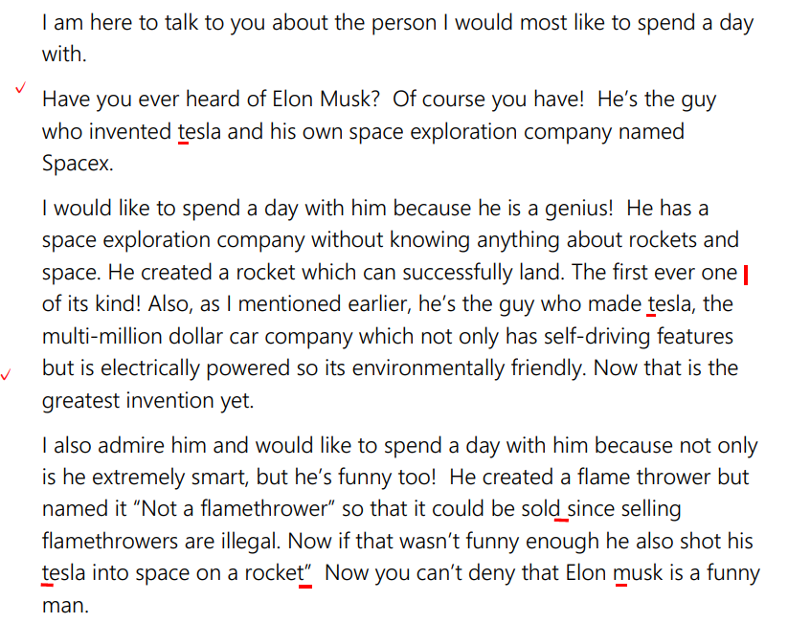
Writing a talk/speech – sample answer

Slide 17
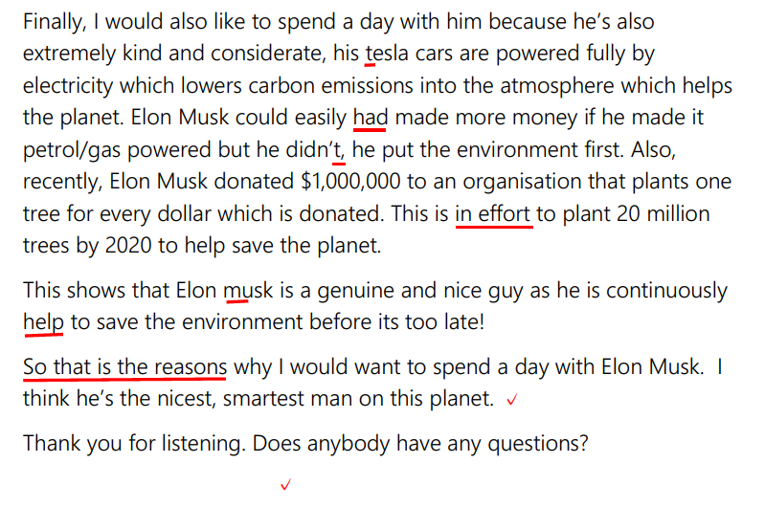
Writing a talk/speech – sample answer

Slide 18
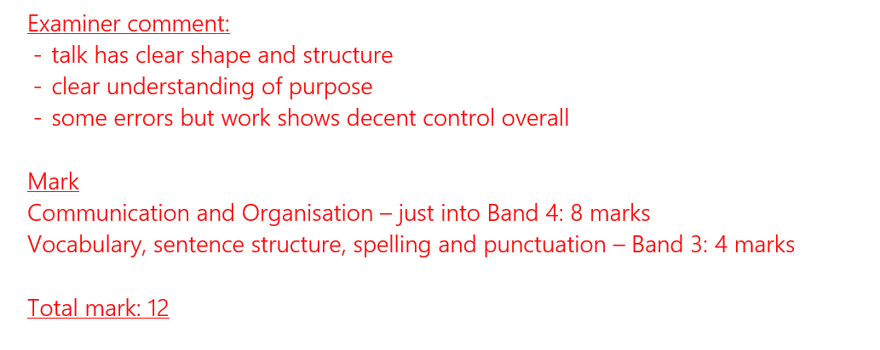
Writing a talk/speech – sample answer

Slide 19
Writing a talk/speech – task
You have been asked to give a talk to your class with the title:
The person I’d most like to spend a day with.
Your talk could be about a person who is famous such as a sportsperson, musician, inventor or national figure, someone from the past or someone who is not necessarily well known but who you admire.
Write what you would say in your talk. [20]
The example that you looked at on slides 16 and 17 would have benefitted from making more points and trying to appeal to or engage the audience.
Use the guidance on how to plan from the previous slides in this presentation and plan your own answer to this question.
When you are happy with your plan, write an answer to this question.
You should spend around 25-30 minutes on this.

Slide 20
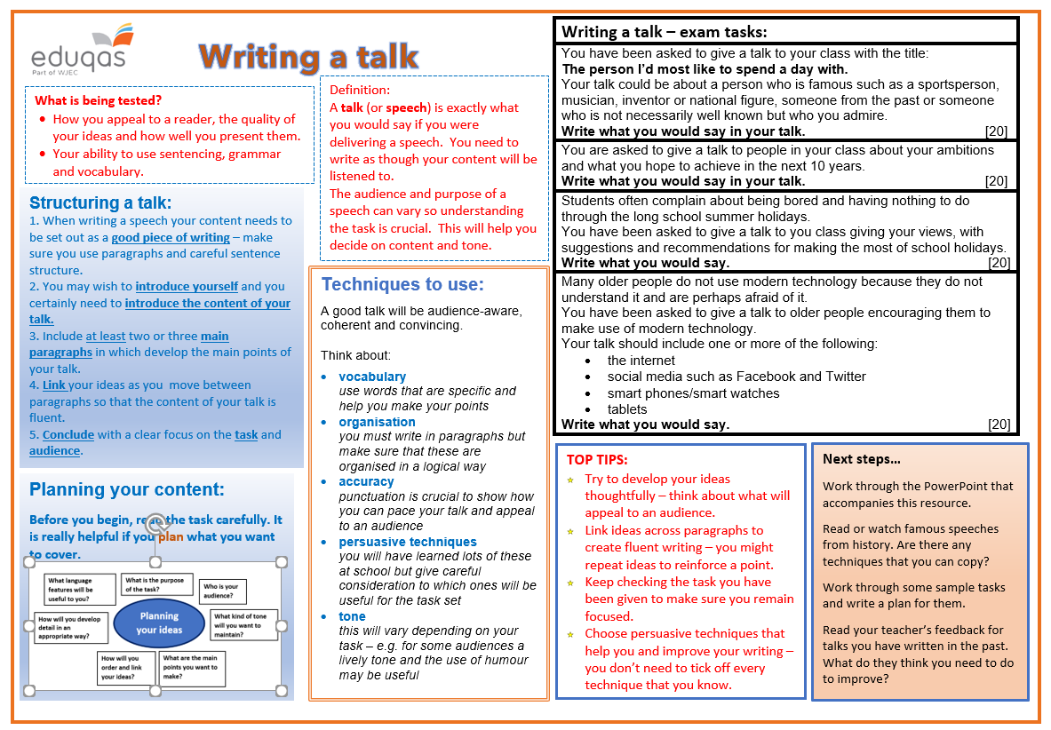
Revision sheet
Click on the link to the following revision sheet. You can print this off to help you when writing a talk:

Slide 21
Finally…
We hope this resource has been helpful to you.
For further information and resources for GCSE English Language you can visit the digital resources section of our website. The following link will take you there:
https://resources.eduqas.co.uk/Pages/ResourceByArgs.aspx?subId=11&lvlId=2

