Slide 1
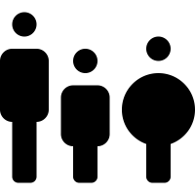
* Learning Objective: 168
Body Mass Index
Success Criteria:
Why measure body fat
Calculating BMI
Test your skills
Why am I doing this ?
Some of us are BiG, some of us are SMALL, but are we HEALHY?

Slide 2
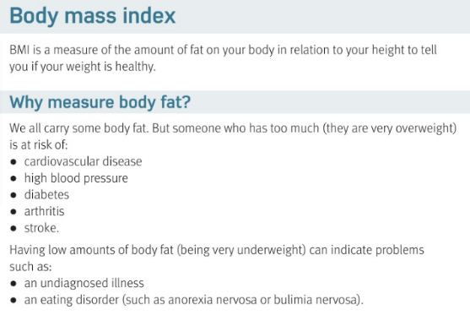

Slide 3
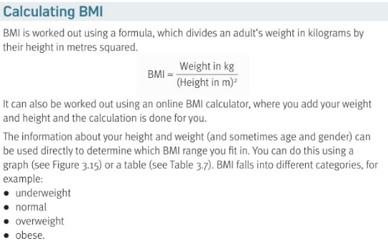

Slide 4
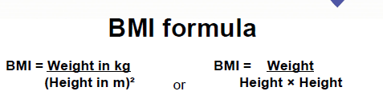

Slide 5
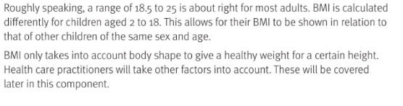
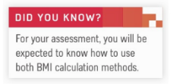

Slide 6
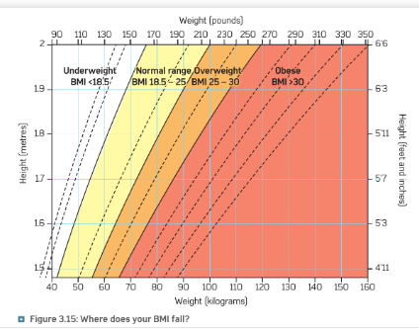

Slide 7
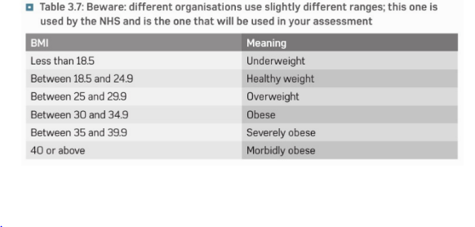

Slide 8
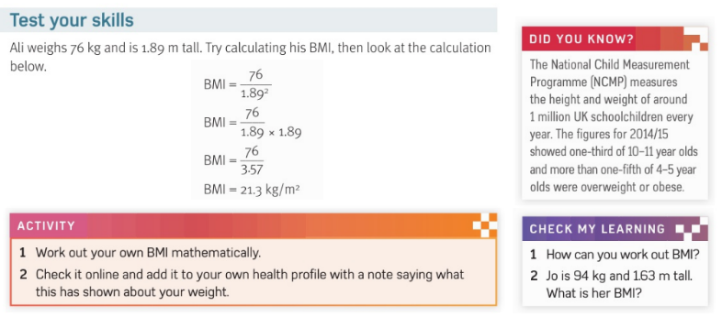

Slide 9
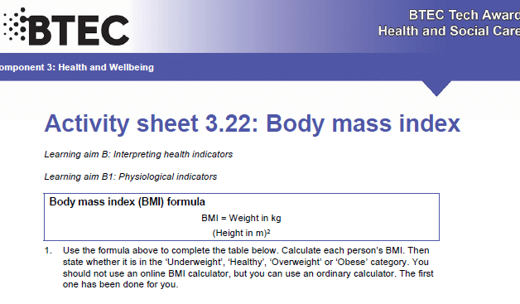

Slide 10
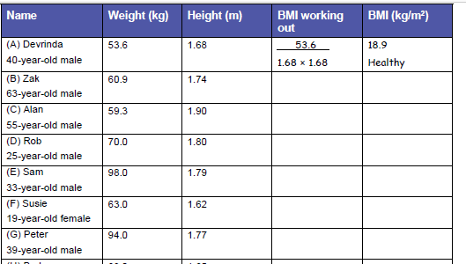
60.9
1.74 x 1.74
40.1
Morbidly obese
59.3
1.9 x 1.9
16.4
underweight
70.0
1.8 x 1.8
21.6
healthy
98
1.79 x1.79
20.1
healthy
63
1.62 x1.62
24
healthy

Slide 11
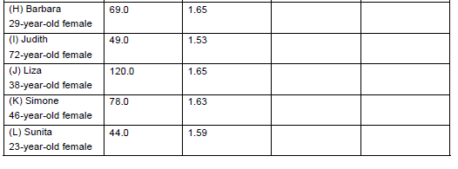
69
1.65 x1.65
20
healthy
49
1.53 x .53
16.1
undrweight
120
1.65 x1.65
111
Dead?
78
1.63 x 1.63
29.3
obese
44
1.59 x1.59
46.9
Morbidly obee

Slide 12
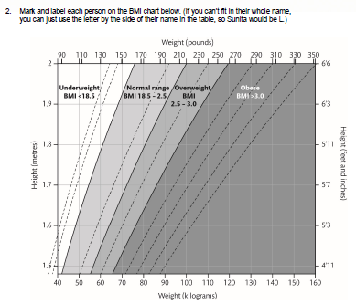

Slide 13
Smhw
H&SC c3 lab BMI
https://www.youtube.com/watch?v=ZHi_A6tC40Y
https://www.youtube.com/watch?v=gaaTW0Elxgg

Slide 14
* Learning Objective: 168
Body Mass Index
Success Criteria:
Why measure body fat
Calculating BMI
Test your skills
Why am I doing this ?
Some of us are BiG, some of us are SMALL, but are we HEALHY?

